Slide 1
Help Wanted Online A real-time measure of job postings
December 2020
Office of Research Connecticut Department of Labor
Connecticut Department of Labor – Research Office 200 Folly Brook Blvd. Wethersfield, CT 06109
Help Wanted Online

Slide 2
What is HWOL?
The Conference Board Help Wanted Online® Data Series (HWOL) measures the number of new, first-time Online job postings and jobs reposted from the previous month for over 50,000 Internet job boards, corporate boards and smaller job sites that serve niche markets and smaller geographic areas.
Connecticut Department of Labor – Research Office 200 Folly Brook Blvd. Wethersfield, CT 06109
Help Wanted Online

Slide 3
Upcoming Release Dates
Monthly Report: Wednesday, January 27, 2020 Wednesday, February 24, 2020 Wednesday, 24, 2020 Weekly New Ads Report: Updated every Friday
Connecticut Department of Labor – Research Office 200 Folly Brook Blvd. Wethersfield, CT 06109
Help Wanted Online

Slide 4
Covid-19 and HWOL
In recent months, the pandemic Coronavirus (Covid-19) has caused significant social and economic implications throughout the world. This monthly HWOL report includes additional info to illustrate how Covid-19 has impacted Connecticut in the short term and highlights recent job postings in the weeks since the virus disrupted both the economy and labor markets. Also included are the statewide and LMA breakdowns of monthly HWOL data as of September 2020.
Connecticut Department of Labor – Research Office 200 Folly Brook Blvd. Wethersfield, CT 06109
Help Wanted Online

Slide 5
Statewide Weekly New Job Ads
Weekly New job postings were 4,613 during the week ending 12/12/20.
Connecticut Department of Labor – Research Office 200 Folly Brook Blvd. Wethersfield, CT 06109
Help Wanted Online

Slide 6
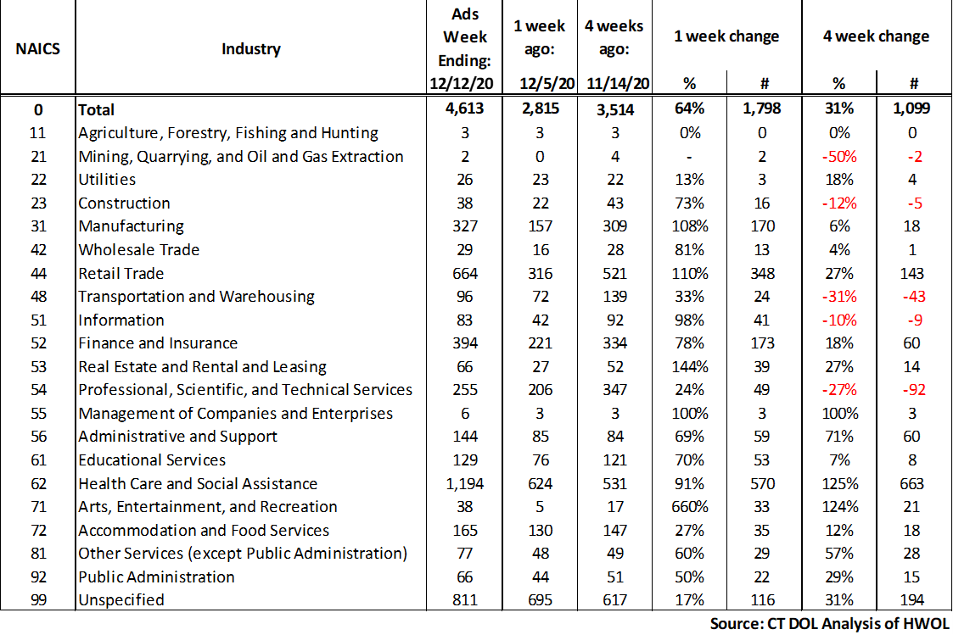
Connecticut Department of Labor – Research Office 200 Folly Brook Blvd. Wethersfield, CT 06109
Help Wanted Online

Slide 7
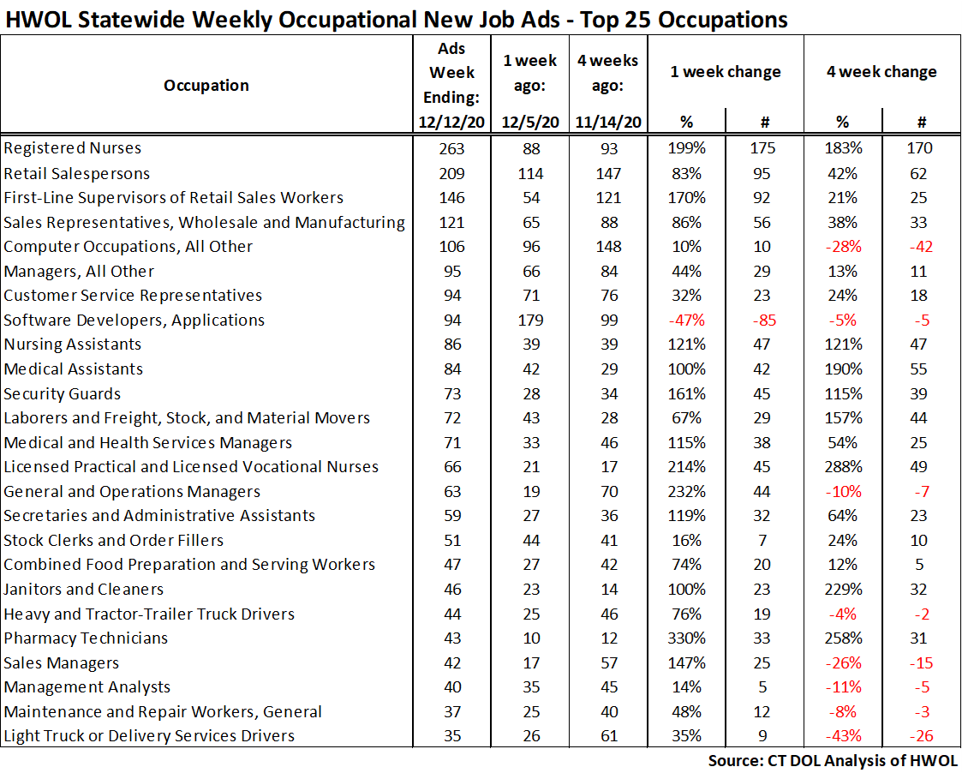
Connecticut Department of Labor – Research Office 200 Folly Brook Blvd. Wethersfield, CT 06109
Help Wanted Online

Slide 8
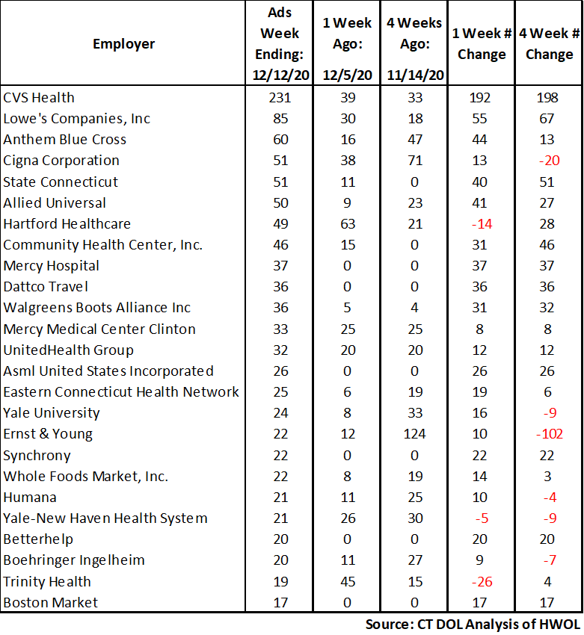
Employers with the Most New Job Postings
Connecticut Department of Labor – Research Office 200 Folly Brook Blvd. Wethersfield, CT 06109
Help Wanted Online

Slide 9
Monthly HWOL Information
The following pages contain HWOL monthly data for November 2020. This includes job posting from when Covid-19 shutdowns impacted many sectors of the Connecticut labor market. Monthly and weekly job ad information can be found here: https://www1.ctdol.state.ct.us/lmi/HWOL.asp
Connecticut Department of Labor – Research Office 200 Folly Brook Blvd. Wethersfield, CT 06109
Help Wanted Online

Slide 10
Statewide Highlights
- Total postings in Connecticut was 48,058 in November 2020. -Industry sectors with the most job postings were Health Care and Social Assistance (9,232 postings), Retail Trade (6,751 postings), Finance and Insurance (4,210 posting), Manufacturing (3,456 postings), and Professional, Scientific, and Technical Services (2,906 postings).
Occupations with the most postings were Retail Salespersons (2,102 postings), Registered Nurses (1,742 postings), Customer Service Representatives (1,241 postings) Sales Representatives, Wholesale and Manufacturing (1,205 postings) and Supervisors of Retail Sales Workers (1,185 postings).
Connecticut Department of Labor – Research Office 200 Folly Brook Blvd. Wethersfield, CT 06109
Help Wanted Online

Slide 11
Connecticut Job Ads by Educational Requirements
Connecticut Department of Labor – Research Office 200 Folly Brook Blvd. Wethersfield, CT 06109
Help Wanted Online

Slide 12
Top Certifications in Connecticut Job Ads
Connecticut Department of Labor – Research Office 200 Folly Brook Blvd. Wethersfield, CT 06109
Help Wanted Online

Slide 13
Top Skills in Connecticut Job Ads
Connecticut Department of Labor – Research Office 200 Folly Brook Blvd. Wethersfield, CT 06109
Help Wanted Online

Slide 14
Top Skills by Industry in Connecticut Job Ads
Connecticut Department of Labor – Research Office 200 Folly Brook Blvd. Wethersfield, CT 06109
Help Wanted Online

Slide 15
Top Skills by Industry in Connecticut Job Ads (Continued)
Connecticut Department of Labor – Research Office 200 Folly Brook Blvd. Wethersfield, CT 06109
Help Wanted Online

Slide 16
Connecticut Department of Labor – Research Office 200 Folly Brook Blvd. Wethersfield, CT 06109
Help Wanted Online

Slide 17
Connecticut Employers with the Most Job Ads
Connecticut Department of Labor – Research Office 200 Folly Brook Blvd. Wethersfield, CT 06109
Help Wanted Online

Slide 18
Connecticut Occupations with the Most Job Ads
Connecticut Department of Labor – Research Office 200 Folly Brook Blvd. Wethersfield, CT 06109
Help Wanted Online

Slide 19
Labor Market Area Data
Labor Market Area Highlights
Job Ads by Industry
Job Ads by Location
Employers With The Most Job Ads
Occupations With The Most Job Ads
Connecticut Department of Labor – Research Office 200 Folly Brook Blvd. Wethersfield, CT 06109
Help Wanted Online

Slide 20
Labor Market Area Highlights
Connecticut Department of Labor – Research Office 200 Folly Brook Blvd. Wethersfield, CT 06109
Help Wanted Online

Slide 21
Connecticut Department of Labor – Research Office 200 Folly Brook Blvd. Wethersfield, CT 06109
Help Wanted Online

Slide 22
Hartford LMA Job Ads by Location
Connecticut Department of Labor – Research Office 200 Folly Brook Blvd. Wethersfield, CT 06109
Help Wanted Online

Slide 23
Hartford LMA Employers
with the Most Job Ads
Cigna Corporation
Hartford Healthcare
Mercy Medical Center Clinton
The Hartford Financial Group
Lowe's Companies, Inc
University of Connecticut
Eastern Connecticut Health Network
Raytheon
The Home Depot Incorporated
Hospital For Special Care
EverSource
Eversource Energy
Whole Foods Market, Inc.
Pearson
Allied Universal
Petco
Fiserv
Guidehouse
Hartford Public Schools
CVS Health
UnitedHealth Group
State of Connecticut
Travelers
Ernst & Young
Trinity Health
Boston Market
United Parcel Service Incorporated
Stanley Black & Decker
Wheeler Clinic
Deloitte
Amazon
Icf Consulting Group Incorporated
Accenture
BJ's Wholesale Club, Inc.
Walgreens Boots Alliance Inc
U.S. Bancorp
Macy's
Advance Auto Parts Incorporated
Connecticut Department of Labor – Research Office 200 Folly Brook Blvd. Wethersfield, CT 06109
Help Wanted Online

Slide 24
Hartford LMA Occupations
with the Most Job Ads
Connecticut Department of Labor – Research Office 200 Folly Brook Blvd. Wethersfield, CT 06109
Help Wanted Online

Slide 25
Connecticut Department of Labor – Research Office 200 Folly Brook Blvd. Wethersfield, CT 06109
Help Wanted Online
25

Slide 26
Bridgeport Stamford LMA Job Ads by Location
Connecticut Department of Labor – Research Office 200 Folly Brook Blvd. Wethersfield, CT 06109
Help Wanted Online

Slide 27
Bridgeport Stamford LMA Employers
with the Most Job Ads
Humana
Deloitte
Stamford Hospital
Whole Foods Market, Inc.
Boston Market
Asml
United Parcel Service Incorporated
Norwalk Public School District
Intuit
Yale-New Haven Health System
Henkel
Interactive Brokers
Thermo Fisher Scientific Inc
Sacred Heart University
State of Connecticut
Apple Inc.
Petco
Compass Group North America
Rolls Royce Plc
Lockheed Martin Corporation
Boehringer Ingelheim
Amazon
Hartford Healthcare
Spectrum
The Home Depot Incorporated
People's United Bank
Lowe's Companies, Inc
CVS Health
NBC
Allied Universal
Macy's
Gartner Group
BJ's Wholesale Club, Inc.
St Vincents Medical Center
UnitedHealth Group
Griffin Hospital
Synchrony
Wheelabrator Technologies Incorporated
Connecticut Department of Labor – Research Office 200 Folly Brook Blvd. Wethersfield, CT 06109
Help Wanted Online

Slide 28
Bridgeport Stamford LMA Occupations
with the Most Job Ads
Connecticut Department of Labor – Research Office 200 Folly Brook Blvd. Wethersfield, CT 06109
Help Wanted Online

Slide 29
Connecticut Department of Labor – Research Office 200 Folly Brook Blvd. Wethersfield, CT 06109
Help Wanted Online

Slide 30
New Haven LMA Job Ads by Location
Connecticut Department of Labor – Research Office 200 Folly Brook Blvd. Wethersfield, CT 06109
Help Wanted Online

Slide 31
New Haven LMA Employers
with the Most Job Ads
Anthem Blue Cross
Yale University
Yale-New Haven Health System
Hartford Healthcare
Boston Market
United Parcel Service Incorporated
Walgreens Boots Alliance Inc
Genesis Healthcare Corporation
Quest Diagnostics Incorporated
University of New Haven
UnitedHealth Group
Department of Veterans Affairs
Southern Connecticut State University
Petco
Intuit
Avangrid, Inc
Quinnipiac University
CVS Health
Amazon
Alexion Pharmaceuticals
BJ's Wholesale Club, Inc.
The Home Depot Incorporated
Lowe's Companies, Inc
Gaylord Specialty Healthcare
Nomad Health
Advance Auto Parts Incorporated
Masonicare Corporation
Allied Universal
Burns & McDonnell
Fair Haven Community Health Care
Vna Community Healthcare
State of Connecticut
H&R Block
Sanofi Aventis
Compass Group North America
Medtronic
Target
Connecticut Department of Labor – Research Office 200 Folly Brook Blvd. Wethersfield, CT 06109
Help Wanted Online

Slide 32
New Haven LMA Occupations
with the Most Job Ads
Connecticut Department of Labor – Research Office 200 Folly Brook Blvd. Wethersfield, CT 06109
Help Wanted Online

Slide 33
Connecticut Department of Labor – Research Office 200 Folly Brook Blvd. Wethersfield, CT 06109
Help Wanted Online

Slide 34
New London LMA Job Ads by Location
Connecticut Department of Labor – Research Office 200 Folly Brook Blvd. Wethersfield, CT 06109
Help Wanted Online

Slide 35
New London LMA Employers
with the Most Job Ads
General Dynamics
Mohegan Sun, Inc
Yale-New Haven Health System
State of Connecticut
United Parcel Service Incorporated
BJ's Wholesale Club, Inc.
Masonicare Corporation
Backus Hospital
Thames Valley Council For Community Action
Atria Senior Living
Utilities Service
Petco
Advantage Sales & Marketing
Reliance Health Group
Tvcca
Bob's Discount Furniture
Dominion Energy Incorporated
Kohl's
Sonalysts Incorporated
Pfizer
Lowe's Companies, Inc
Mohegan Sun
The Home Depot Incorporated
Care At Home
Norwich Public Schools
Genesis Healthcare Corporation
Aveanna
Compass Group North America
Aldi
UnitedHealth Group
Groton Public Schools
Intuit
Staples
Asplundh Tree Expert Company
Target
United Community Family Services Incorporated
Dish Network
Connecticut Department of Labor – Research Office 200 Folly Brook Blvd. Wethersfield, CT 06109
Help Wanted Online

Slide 36
New London LMA Occupations
with the Most Job Ads
Connecticut Department of Labor – Research Office 200 Folly Brook Blvd. Wethersfield, CT 06109
Help Wanted Online

Slide 37
Connecticut Department of Labor – Research Office 200 Folly Brook Blvd. Wethersfield, CT 06109
Help Wanted Online

Slide 38
Danbury LMA Job Ads by Location
Connecticut Department of Labor – Research Office 200 Folly Brook Blvd. Wethersfield, CT 06109
Help Wanted Online

Slide 39
Danbury LMA Employers
with the Most Job Ads
BJ's Wholesale Club, Inc.
Macy's
Petco
The Home Depot Incorporated
Western Connecticut Health Network
UnitedHealth Group
Genesis Healthcare Corporation
Danbury Public Schools
Iqvia
Intuit
CVS Health
Staples
Bureau of Prisons
Maplewood At Stony Hill, Llc
Olive Garden
Amazon
Entegris Incorporated
Realogy Franchise Group LLC
Sodexo
Lowe's Companies, Inc
Boston Market
Whole Foods Market, Inc.
United Parcel Service Incorporated
Compass Group North America
Advantage Sales & Marketing
Apple Inc.
Cds Corporate
Kohl's
Aldi
LHC Group
Target
Chrysler
National Vision Incorporated
Select Medical
Chick-fil-A
Gap Inc.
Regional Hospice Of Western Connecticut
TJX Companies, Inc.
Connecticut Department of Labor – Research Office 200 Folly Brook Blvd. Wethersfield, CT 06109
Help Wanted Online

Slide 40
Danbury LMA Occupations
with the Most Job Ads
Connecticut Department of Labor – Research Office 200 Folly Brook Blvd. Wethersfield, CT 06109
Help Wanted Online

Slide 41
Connecticut Department of Labor – Research Office 200 Folly Brook Blvd. Wethersfield, CT 06109
Help Wanted Online

Slide 42
Waterbury LMA Employers
with the Most Job Ads
Waterbury Hospital
Trinity Health
State Farm Insurance Companies
United Parcel Service Incorporated
Wheeler Clinic
Genesis Healthcare Corporation
New Incorporated
Betterhelp
Easter Seals
Seasons Hospice & Palliative Care
Ametek Incorporated
Naugatuck Valley Community College
East Coast Flooring
O'Reilly Automotive Inc
Petco
State of Connecticut
Chevrolet
Macy's
Refocus Eye Health
Mercy Medical Center Clinton
Post University
Intuit
CDM Smith
BJ's Wholesale Club, Inc.
Amazon
Keystone Human Services
Waterbury Public Schools
Connecticut Renaissance
Mercy Hospital
The Home Depot Incorporated
Girls Incorporated
Drew Marine Usa
Hartford Healthcare
Olive Garden
Staples
Advantage Sales & Marketing
Global Companies Llc
Naugatuck Public Schools
Connecticut Department of Labor – Research Office 200 Folly Brook Blvd. Wethersfield, CT 06109
Help Wanted Online

Slide 43
Waterbury LMA Job Ads by Location
Connecticut Department of Labor – Research Office 200 Folly Brook Blvd. Wethersfield, CT 06109
Help Wanted Online

Slide 44
Waterbury LMA Occupations
with the Most Job Ads
Connecticut Department of Labor – Research Office 200 Folly Brook Blvd. Wethersfield, CT 06109
Help Wanted Online

Slide 45
Connecticut Department of Labor – Research Office 200 Folly Brook Blvd. Wethersfield, CT 06109
Help Wanted Online

Slide 46
Torrington LMA Job Ads by Location
Connecticut Department of Labor – Research Office 200 Folly Brook Blvd. Wethersfield, CT 06109
Help Wanted Online

Slide 47
Torrington LMA Employers
with the Most Job Ads
Hartford Healthcare
Health Quest
Devereux Advanced Behavioral Health
Mayflower Inn & Spa
Alternative Employment Incorporated
Dymax Corporation
Intuit
Walgreens Boots Alliance Inc
Connecticut Junior Republic
Petco
Ems Llc
Regalcare At Torrington
Staples
Brandywine Living
Crate & Barrel
Fuelcell Energy Inc
Ocean State Job Lot
Roehl Transport
Target
Lowe's Companies, Inc
BJ's Wholesale Club, Inc.
Mohawk Mountain Ski Area Inc
Becton Dickinson
United Parcel Service Incorporated
Amazon
Mountainside Treatment Center
Charlotte Hungerford Hospital
The Arc Of Litchfield County, Inc
Outer Armor By Commercial Sewing, Inc
Compass Group North America
Og Industries Incorporated
Sharon Health Care Center
State of Connecticut
Community Health Wellness
Fogo De Chao
Mental Health Connecticut Inc
People's United Bank
State Farm Insurance Companies
Connecticut Department of Labor – Research Office 200 Folly Brook Blvd. Wethersfield, CT 06109
Help Wanted Online

Slide 48
Torrington LMA Occupations
with the Most Job Ads
Connecticut Department of Labor – Research Office 200 Folly Brook Blvd. Wethersfield, CT 06109
Help Wanted Online

Slide 49
Connecticut Department of Labor – Research Office 200 Folly Brook Blvd. Wethersfield, CT 06109
Help Wanted Online

Slide 50
Enfield LMA Job Ads by Location
Connecticut Department of Labor – Research Office 200 Folly Brook Blvd. Wethersfield, CT 06109
Help Wanted Online

Slide 51
Enfield LMA Employers
with the Most Job Ads
Raytheon
Advance Auto Parts Incorporated
The Lego Group
State of Connecticut
Massachusetts Mutual Life Insurance
United Parcel Service Incorporated
Olive Garden
The Home Depot Incorporated
Allied Community Services Incorporated
Serta Incorporated
Vinfen
Ashley Furniture
Petco
CVS Health
Reyes Holdings
Aldi
Eppendorf
Hanwha Aerospace Usa
TJX Companies, Inc.
C&S Wholesale Grocers
Es3 Llc
Allied Community Services
FedEx
Gandara Center
Community Health Resources
Walgreens Boots Alliance Inc
Hertz Corporation
Staples
Advantage Sales & Marketing
Hp Hood Incorporated
Pinnacle Logistics
Enterprise Rent-A-Car
Target
Connecticut Conference Of Municipalities
Gat Airline Ground Support
Safeguard Security
Watermark Retirement Communities
Connecticut Department of Labor – Research Office 200 Folly Brook Blvd. Wethersfield, CT 06109
Help Wanted Online

Slide 52
Enfield LMA Occupations
with the Most Job Ads
Connecticut Department of Labor – Research Office 200 Folly Brook Blvd. Wethersfield, CT 06109
Help Wanted Online

Slide 53
Connecticut Department of Labor – Research Office 200 Folly Brook Blvd. Wethersfield, CT 06109
Help Wanted Online

Slide 54
Danielson LMA Job Ads by Location
Connecticut Department of Labor – Research Office 200 Folly Brook Blvd. Wethersfield, CT 06109
Help Wanted Online

Slide 55
Danielson-Northeast LMA Employers
with the Most Job Ads
Lowe's Companies, Inc
Morgan Corporation
Sonoco Products Company
Generations Family Health Center
Hartford Healthcare
Asplundh Tree Expert Company
Danaher Corporation
Echelon Business Services
Amazon
Companions Homemakers Incorporated
Sterling Community School
Ameri Kleen
Dish Network
Learning Clinic Incorporated
State of Connecticut
Advance Auto Parts Incorporated
Change Incorporated
Crossmark
Mattress Firm
Day Kimball Healthcare
Staples
United Parcel Service Incorporated
Quality Homemakers Incorporated
Hampton
Sonoco Works
Dattco
United Services Incorporated
Capstone Logistics Group
Foster Company
Utilities Service
Compass Group North America
Keycorp
Rogers Corporation
Whitcraft Company
Asplundh Tree Expert
Community Residences Incorporated
Loos Company Incorporated
O'Reilly Automotive Inc
Connecticut Department of Labor – Research Office 200 Folly Brook Blvd. Wethersfield, CT 06109
Help Wanted Online

Slide 56
Danielson-Northeast LMA Occupations
with the Most Job Ads
Connecticut Department of Labor – Research Office 200 Folly Brook Blvd. Wethersfield, CT 06109
Help Wanted Online

Slide 57
All advertisement data used in this publication is from the Conference Board’s Help Wanted Online data series.
For more information or data requests, contact Matthew Krzyzek in the Office of Research at the Department of Labor.
(860) 263-6287
Matthew.Krzyzek@ct.gov
For more Connecticut Labor Market Information visit:
www.ctdol.state.ct.us/lmi
https://www.facebook.com/ctlmi
Twitter: @DOL_Research
Connecticut Department of Labor – Research Office 200 Folly Brook Blvd. Wethersfield, CT 06109
Help Wanted Online

